Slide 1

Sprint #3 End Presentation
Notes:
Alex

Slide 2


Sprint #3 Goals
Restructure login page to use with React.js
Update documents and diagrams
Start to gather data to help fetch instructions from recipe websites
Notes:
Dane

Slide 3
Updates
Business Requirement Document
No updates
Product Requirement Document
Updated Sprint Board, Gantt Chart, Burndown Chart, Project Tracker
Architecture and Design Document
Components diagram, trade-off analysis updates, machine learning analysis
Notes:
Dane

Slide 4
User Stories
Planned: 82 points
Completed: 40 points
We planned to complete more user stories this sprint, but due to some complications with our login page before we couldn’t complete them
Essentially, we had to re-complete user stories that were considered completed before do to practically redoing the login page
Notes:
Dane

Slide 5
User Stories
System Admin
As a system admin, I want to be able to add a Guest User so that they can become an Account User. (2 points)
As a system admin, I want to be able to delete an Account User so that Account cannot be used. (2 points)
As a system admin, I want to be able to update the details of my application so that the application will keep updated details always. (2 points)
Guest User
As a guest user, I want to be able to search for recipes so that I can use the feature of the system to search for the recipe and preparation that I need. (34 points)
As a guest user, I want to be able to register for an account so that I can become an Account User and use the Account User’s features. (13 points)
As a guest user, I want to be able to sort the recipes I have searched so that I can view them by multiple categories in order to search for specific ones. (5 points)
Notes:
Dane

Slide 6
User Stories
Account User
As an account user, I want to be able to search for recipes so that I can use the feature of the system to search for the recipe and preparation that I need. (34 points)
As an account user, I want to be able to login to the system so that I can use the features of the system to accomplish what I need. (21 points)
As an account user, I want to be able to reset my password so that I can create a new password to login to the system. (8 points)
As an account user, I want to view my list of recipes so that I can check on the details of my list of recipes. (21 points)
As an account user, I want to be able to add recipes to my list so that I can save the recipe into a list of other recipes for future use. (13 points)
As an account user, I want to be able to delete recipes off my list so that I can get rid of recipes that do not interest me any longer. (8 points)
As an account user, I want to be able to sort the recipes I have searched so that I can view them by multiple categories in order to search for specific ones. (5 points)
Notes:
Dane

Slide 7
Code Demo
https://look-n-cook.firebaseapp.com/ User Manual: shorturl.at/bgrsz
Notes:
Dane
Full URL
https://github.com/JohnO135/491SeniorProject/blob/master/Documents/User%20Manual%20v1.1.pdf

Slide 8
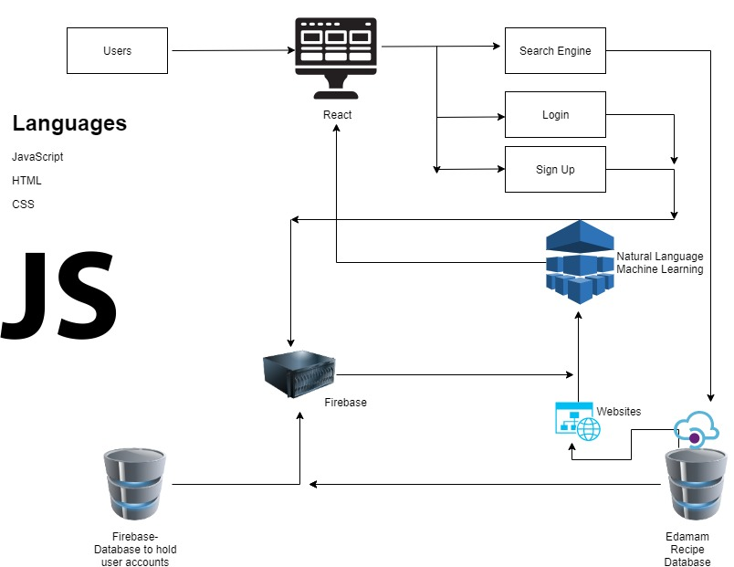
Architecture
React.js used for front-end
User Platforms:
Chrome Extension
Web application
Notes:
Jose

Slide 9
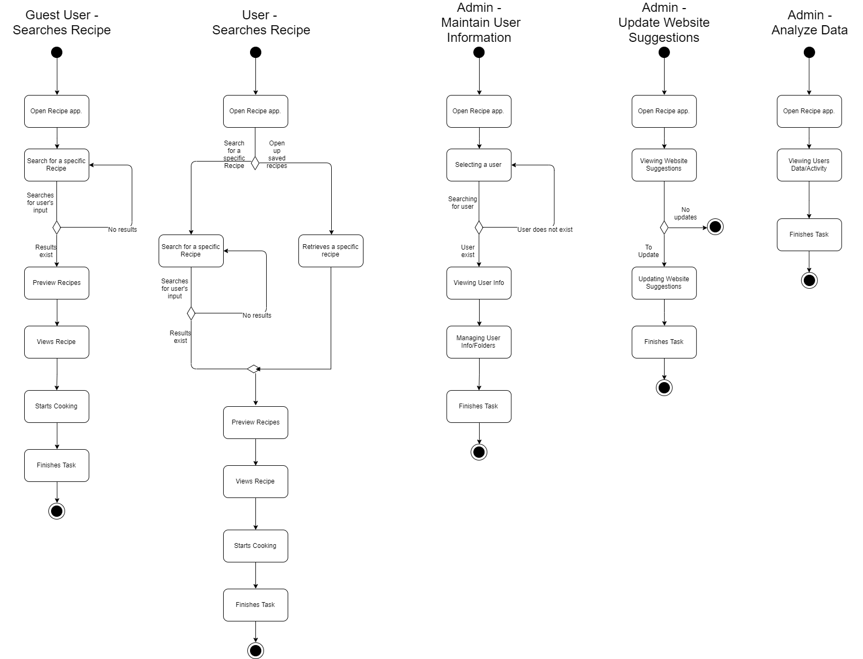
Activity Diagram
Notes:
jose

Slide 10
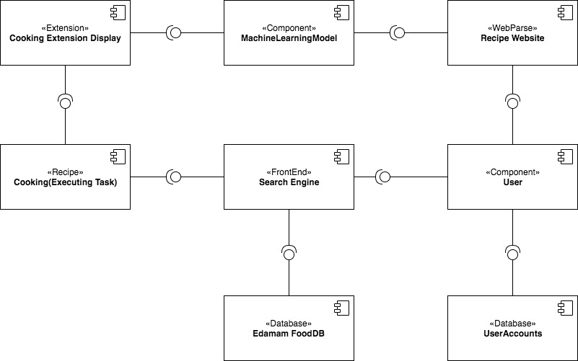
Component Diagram
Notes:
jose

Slide 11
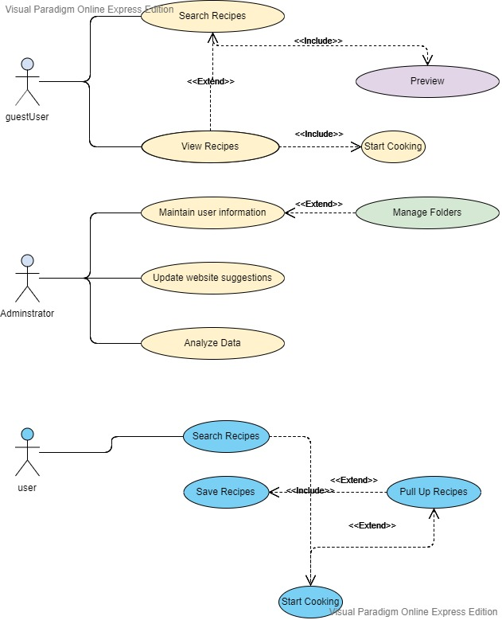
Use Case Diagrams
Notes:
jose

Slide 12
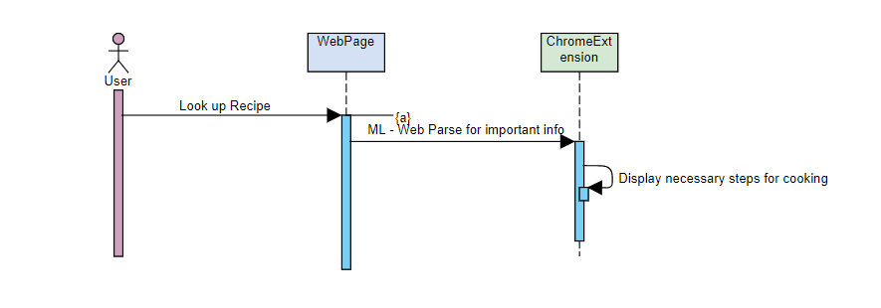
Sequence Diagrams
Notes:
jose

Slide 13
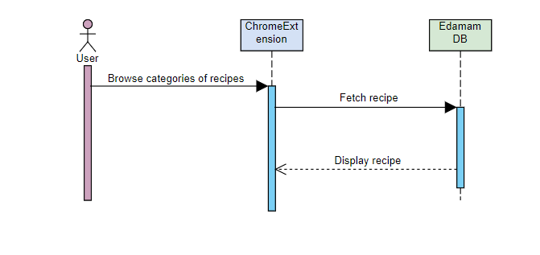
Sequence Diagram
Notes:
jose

Slide 14
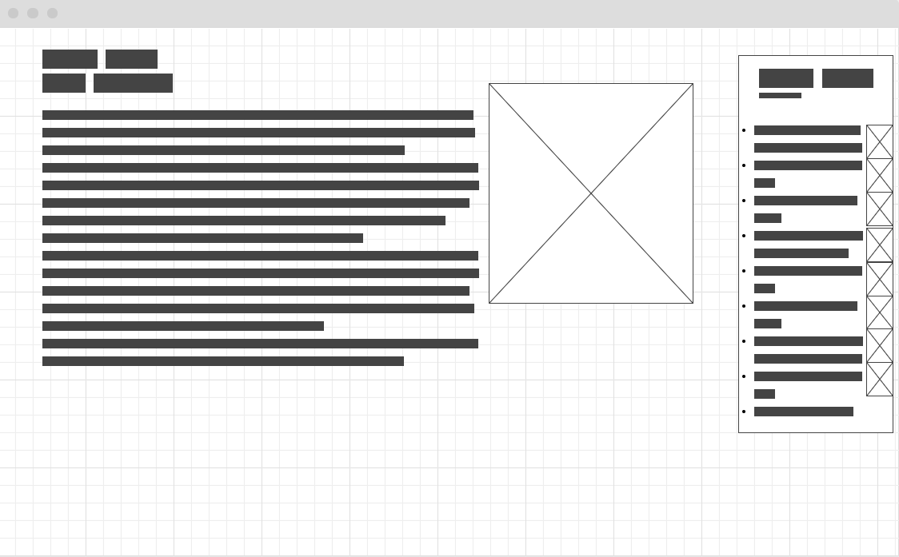
Wireframe
Notes:
jose

Slide 15
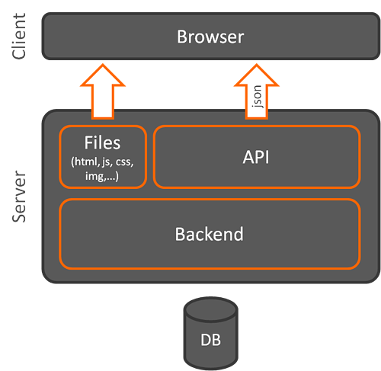
Client Side Architecture
Works in this general model:
Client devices send requests to the server
Server takes upon client requests
Fetch data from the server and returns as HTML
JSON if an API is used
Considerations:
Model-View-View-Model (MVVM)
Model-View-Controller (MVC)
Notes:
jose

Slide 16

React.js
Reasons for choosing React.js
Recommended by colleagues
Reusability of React Components
Smaller learning scale due to it being a library
Problems occured:
JSX - Mixture of HTML and JavaScript often creates confusion
Deployment of the login functionality
Notes:
john

Slide 17

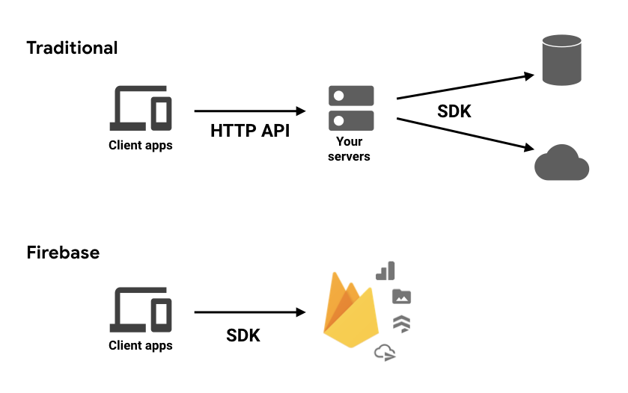
Firebase
Reasons for choosing firebase
Recommended by colleagues
Real-time database - data hosted on cloud and synchronized
Accessibility of Machine Learning
Auth, Email, Hosting, Backend, Uptime automatically provided
Middleware: Firebase Firestore
Our current experience:
Very simple to navigate and did not cause many complications in our development
Notes:
john

Slide 18

Recipe Finder
Compile a list of cooking vocabulary to find the most common words
Use those words to distinguish between a recipe or a non-recipe
Notes:
alex

Slide 19
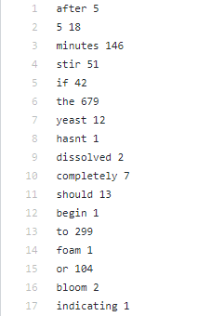
Recipe Finder
We are still gathering more words
Keep track of the recipes that we have already used to reduce redundancy
Record only 5 recipes of a certain food type for consistency
Using a program that reads a paragraph and splits them into individual words then adds them into a text file

Slide 20
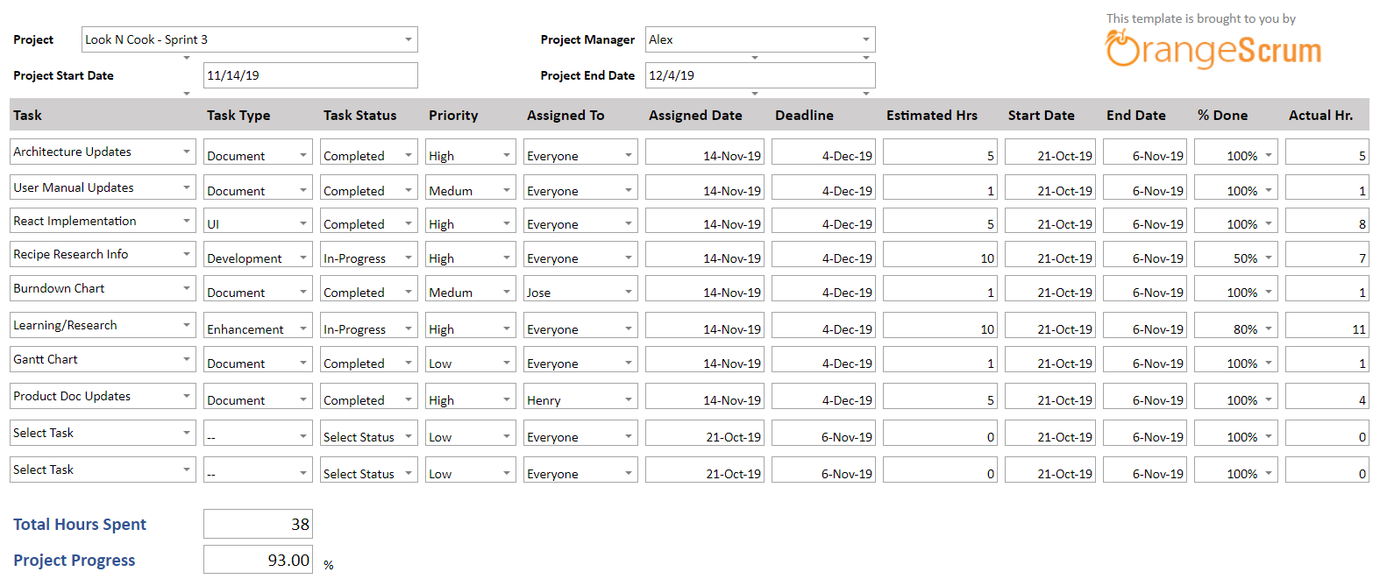
Project Tracker
Notes:
Henry

Slide 21
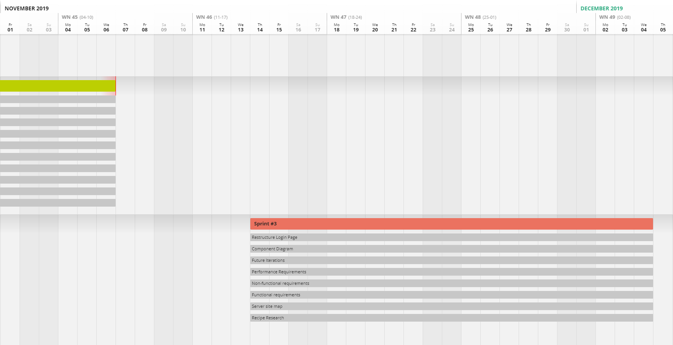
Gantt Chart

Slide 22
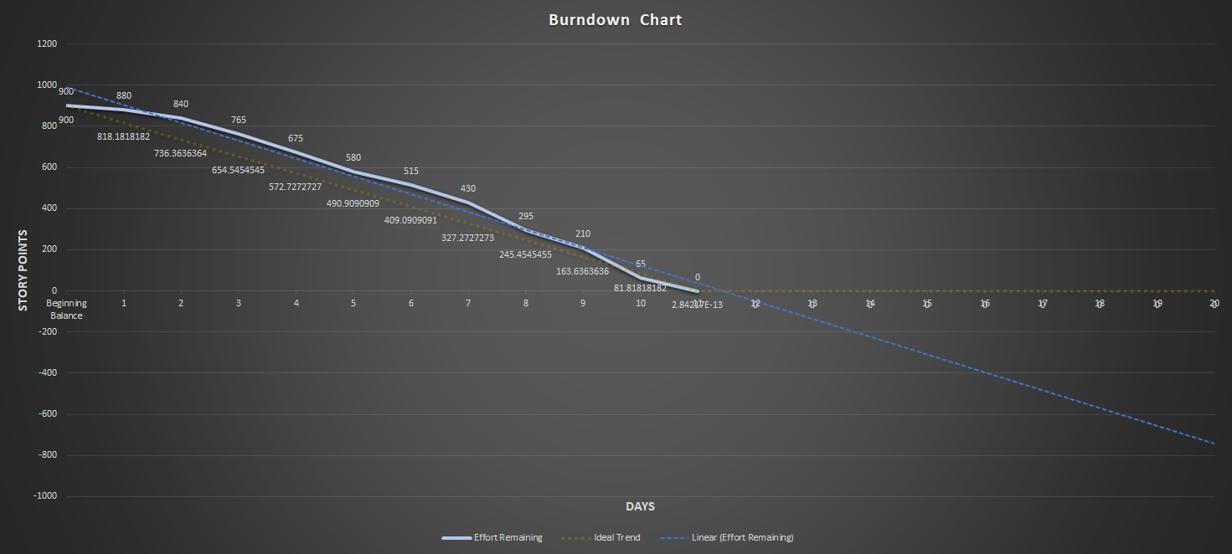
Burndown Curve
Notes:
Jose

Slide 23
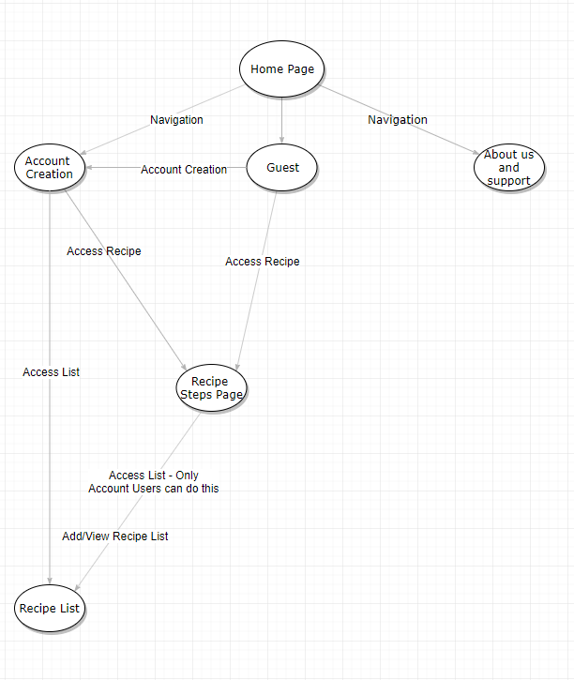
Server Site Map

Slide 24
Functional Requirements
Account users can edit their own information such as username, password, and other information after user account creation.
There will be a string limits upon the user account creation process.
There will be a prompt for the user to login or view as a guest upon the home page.
After a recipe have been created, the user can select whether or not they would like to view another recipe.
In the search bar, there will be a string limit of 50 words.
There will be a choice of saving a recipe to an account’s list upon searching.
The user will have a choice to display all their saved recipes from the account’s recipe list.
Users can request support from the support team if any error occurs upon usage of the application.
There are no limits to the amount of recipes an account user can save.
The step-by-step process of a recipe shall be numbered in the appropriate order.
System administrators can maintain the application as well as the account information of all registered users.
Guest Users must be registered in order to save recipes to a dedicated list.
All users should be able to sort the recipes by multiple categories when searching for a specific recipe.

Slide 25
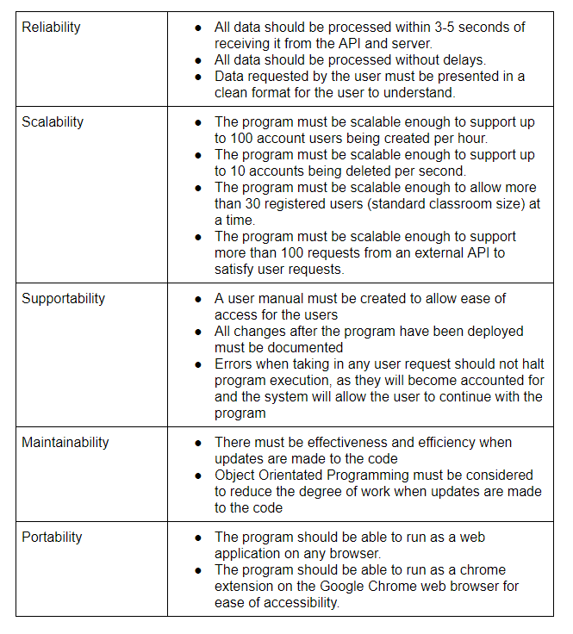
Non-Functional Reqs

Slide 26
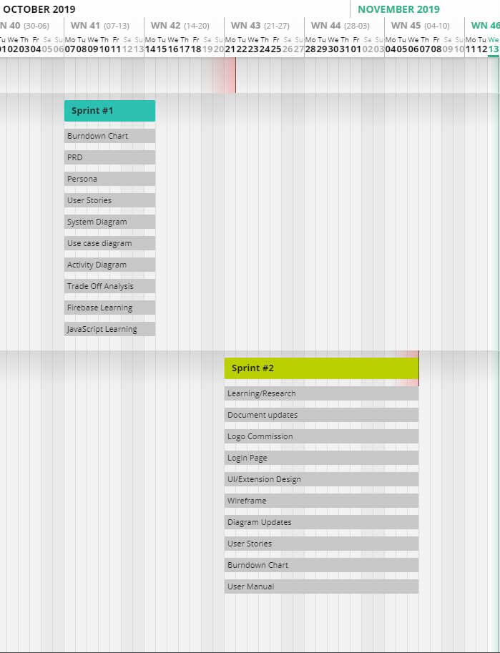
Gantt Chart
Notes:
henry

Slide 27
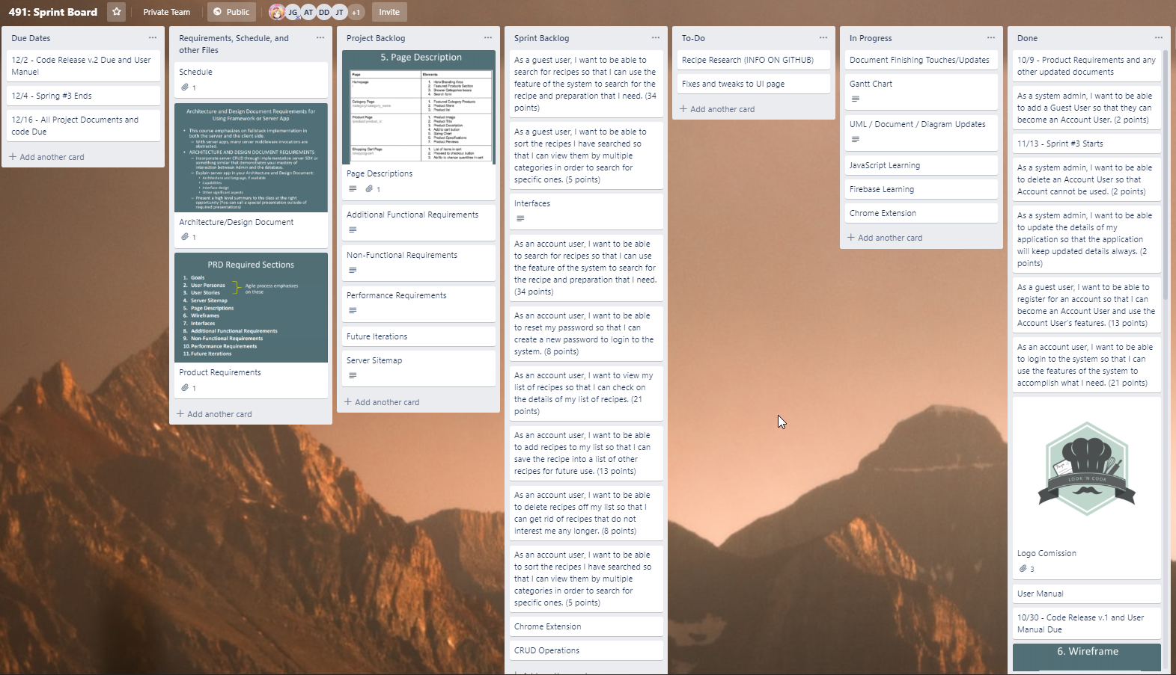
Sprint Board-Before
Notes:
henry

Slide 28
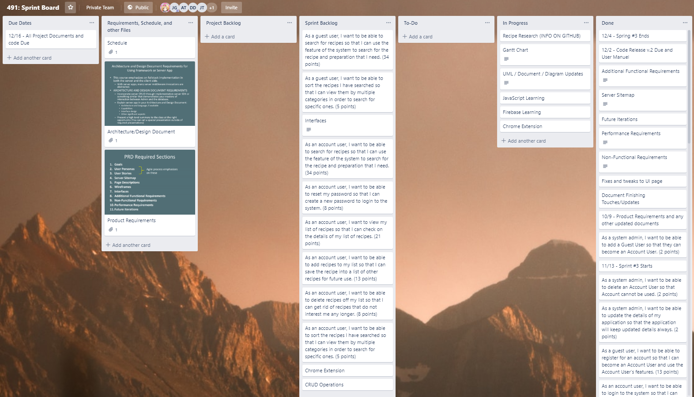
Sprint Board-After
Notes:
henry

Slide 29
Sprint Retrospective
Did we meet our Sprint Goal?
Yes, a lot of this sprint was focused on restructuring the login page to get it deployed and we were able to start gathering data for searching recipes
What worked well/Didn’t work well?
We were able to get the login page deployed using React
Data gathering went well; it’s just a matter of inputting more recipes for more data
Couldn’t really get to completing user stories
What caused problems?
Homework cut into time we would’ve like to use to work more on the project
Having to basically redo the login page in a different format prevented us from working more on the UI like we planned to
How to improve for next sprint/Conclusions
Now that the login page is deployed on a website, can have more focus on UI as originally planned
Focus more on completing the user stories
Gather more information regarding data retrieval from recipe websites
Notes:
henry

Slide 30

Plans for the next sprint
Improve UI and look of webpage
Start delving into more coding in addition to Integration of the Recipe API
Notes:
alex

